Slide 1
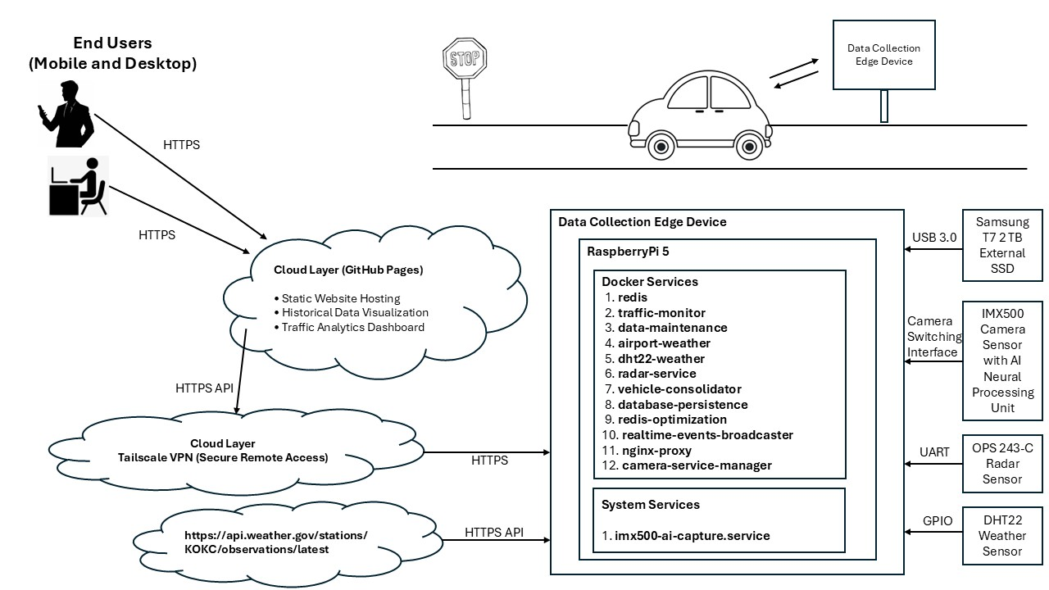
Advisor Name:
Dr. Aiman Darwiche
Grand Canyon University
Raspberry Pi 5 Edge ML Traffic Monitoring System
Steven Merkling
CONTEXT & BACKGROUND
Problem Statement:
Traditional traffic monitoring systems cost $15,000-50,000+ and require extensive infrastructure. Communities need affordable, accurate, and privacy-preserving solutions for traffic safety monitoring.
Project Objectives:
Deploy a proof of concept for a low-cost, scalable edge-based traffic monitoring system
Achieve real-time vehicle detection with <350ms total latency
Perform on-camera AI inference using hardware-accelerated NPU (sub-100ms)
Implement multi-sensor data fusion (radar, camera, environmental sensors)
Provide secure remote access and real-time data visualization
Innovation Focus:
Multi-sensor edge AI processing combining Doppler radar with on-camera neural processing for comprehensive traffic analytics while maintaining privacy through local data processing.
SYSTEM ARCHITECTURE
Hardware Components
Core Computing Platform:
Raspberry Pi 5 (16GB RAM, ARM Cortex-A76 @ 2.4GHz)
Sony IMX500 AI Camera (3.1 TOPS NPU, 12.3MP, sub-100ms inference)
OPS243-C FMCW Doppler Radar (24.125 GHz, 200m range, ±0.1 mph accuracy)
DHT22 Temperature/Humidity Sensor (GPIO4, environmental monitoring)
Samsung T7 Shield 2TB External SSD (USB 3.2 Gen 2)
Weatherproof IP65/IP66 enclosure
METHODOLOGY & DATA FLOW
Hardware
• OPS243-C Doppler Radar (24.125 GHz, 0-200m range)
• IMX500 AI Camera (3.1 TOPS NPU, 87ms inference)
• Weather Sensors (Airport API + DHT22 local)
Workflow (300ms End-to-End)
T+0-50ms:
Radar detects vehicle → UART → Redis Pub/Sub
T+50-150ms:
Parallel processing (Camera AI + Weather + Consolidation)
T+150-300ms:
SQLite persistence + WebSocket broadcast to web dashboard
Architecture
17 data handoffs across microservices
Redis message broker (Pub/Sub, Streams, Key-Value)
SQLite database (90-day retention, batch writes)
Nginx reverse proxy (TLS, WebSocket upgrade)
Key Features
Real-time multi-sensor fusion with correlation IDs
Secure WebSocket streaming (Socket.IO over TLS)
RESTful API for historical queries
Sub-second latency from detection to dashboard
RESULTS & PERFORMANCE
Inference Performance
• Primary Vehicle Classifications: 85-95% accuracy
• Inference Latency: Sub-100ms on IMX500 NPU
• Detection Ranges: Camera 5-50m, Radar 2-200m
• Multi-Vehicle Tracking: SORT algorithm with Kalman filtering
• Total Event Latency: <350ms (sensor → storage)
System Metrics
• CPU Usage: 100% reduction for AI processing (hardware-accelerated on NPU)
Inference Speed: 25-50x faster than software AI (sub-100ms vs 2-5 seconds)
Storage Optimization: 94% reduction through intelligent data management
Continuous Uptime: 24+ hours with automated monitoring and recovery
Real-Time Latency: Sub-second WebSocket streaming
Storage Efficiency
• Database: SQLite with normalized schema, 90-day retention
• Automated Cleanup: Image age limits (24 hours), log rotation (30 days)
• Emergency Management: 90% threshold triggers cleanup
• External Storage: 2TB SSD with tmpfs optimization
TECHNICAL INNOVATIONS
Radar-Triggered Edge AI: Novel approach using radar as primary detector to trigger on-camera AI processing, achieving significant power and storage savings while maintaining detection accuracy.
Privacy-Preserving Architecture: All AI processing occurs on-device using Sony IMX500's built-in neural processing unit, eliminating need to transmit raw video data.
Scalable Solution:
• Modular architecture supports easy replication
Low Barrier to Entry:
• ~$1,000 hardware cost for complete system
Open Source Potential:
• Docker-based deployment simplifies distribution
AI-Assisted Development Methodology: All code within this project was generated using Visual Studio Code and Microsoft Copilot
This AI-assisted methodology enabled:
Rapid prototyping of microservices architecture
Consistent code quality across 12 containerized services
Efficient debugging through AI-powered analysis
Documentation generation aligned with implementation
CONCLUSIONS & IMPACT
Project Achievements:
• Complete Microservices Implementation:
• 12 containerized services + 1 host service
• Production-Ready Deployment:
• 24/7 continuous operation with health monitoring
• Hardware-Accelerated AI:
• 100% CPU reduction for inference via IMX500 NPU
• Multi-Sensor Fusion:
• Radar, camera, and environmental data correlation
• Secure Remote Access:
• Tailscale VPN with HTTPS/TLS encryption
• Cloud Integration:
• GitHub Pages dashboard for historical analytics
• Automated Operations:
• Health checks, restart policies, storage management
• Real-Time Streaming:
• WebSocket broadcasting with sub-second latency
Research Contribution:
• Demonstrated viability of edge AI for traffic monitoring
• Validated multi-sensor fusion architecture for enhanced accuracy
• Established microservices pattern for embedded IoT systems
• Documented AI-assisted methodology for complex projects
I would like to acknowledge .... Dr. Aiman Darwiche (Faculty Advisor), Grand Canyon University Computer Science Department, my workplace managers and finally my family and their unending support and confidence.

